Slide 1
KS4 Transition – Year 9 to Year 10
Subject: Computer Science
Contact: Will O’Dowd
Exam Board: OCR
Course Outline: A GCSE subject covering all
major areas of using computer technology.
Type of Assessment: Two exams
Pre-Reading List:
GCSE OCR Computer Science (CGP books)
Useful Links:
https://code.org/educate/resources/videos
https://www.bbc.co.uk/bitesize/subjects/z34k7ty
"Transforming lives through learning"
Key Terminology
Analyse, Construct, Design
Subject Specific Terminology
ALU, Cache, CPU, RAM, ROM
Activities to complete before joining:
Transition task: Computer Assembly Guide (see next slides)
Transition task: Internet access

Slide 2
Computer System Components & Assembly Guide
Written by: Name

Slide 3
Instructions
You are going to create a presentation on ‘how to construct a full computer system’.
You have been given lot of pictures of internal hardware inside the computer.
Place pictures together on the correct slide.
Place slides in the correct order.
Add some text to explain how all the parts fit together to create a ‘computer system’.
Use the internet to help you.

Slide 5
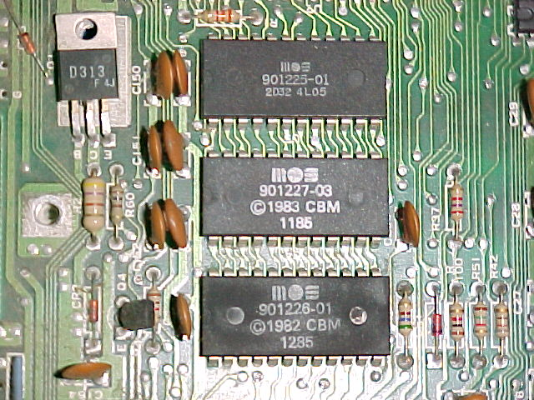
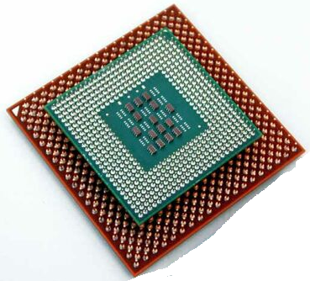

Slide 6
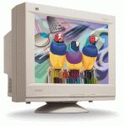

Slide 7
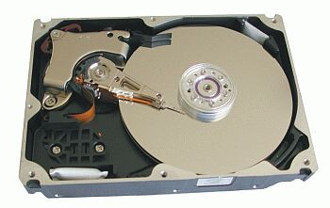
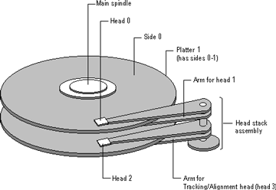

Slide 10
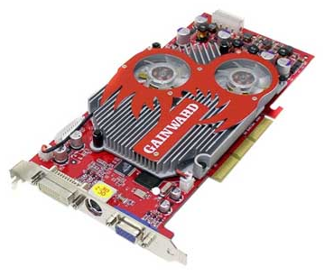
A graphics card

Slide 11
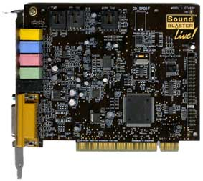
A Sound card

Slide 12
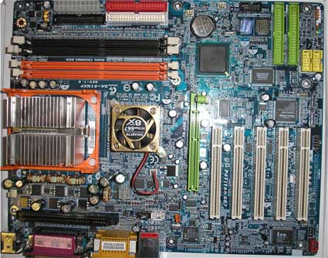

Slide 15
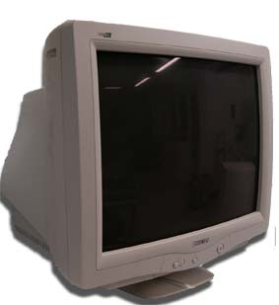
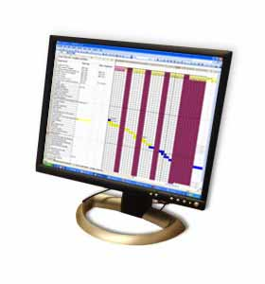

Slide 16
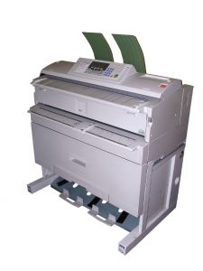
A Laser Printer

Slide 17
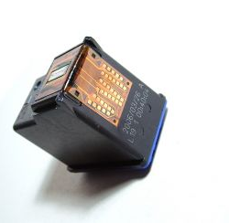
A Inkjet Printer

Slide 18
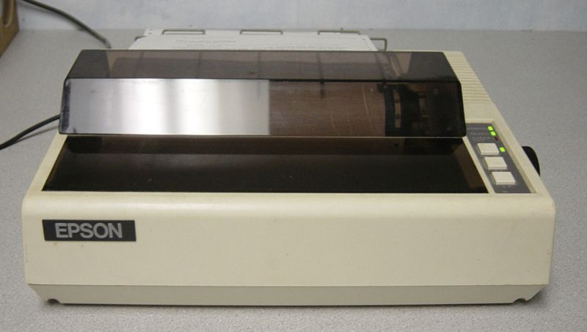
Dot Matrix Printer

Slide 19
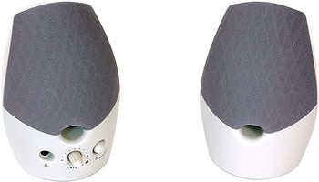

Slide 20
ROM

Slide 21
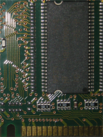
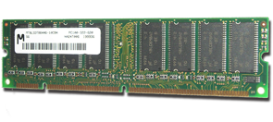
RAM

Slide 22
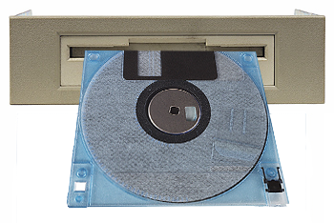
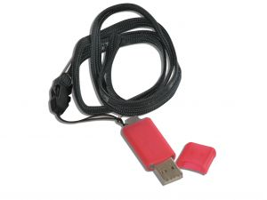

Slide 23
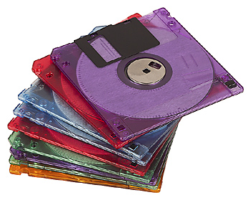
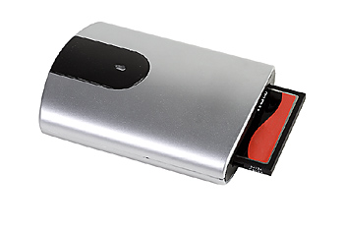

Slide 24
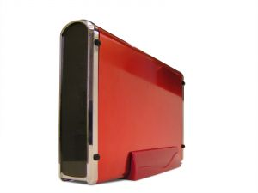
Hard Disk
RAID
Removable Disk

Slide 25
Backing Storage

Slide 26
DVD-RW

Slide 27
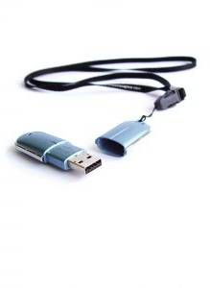
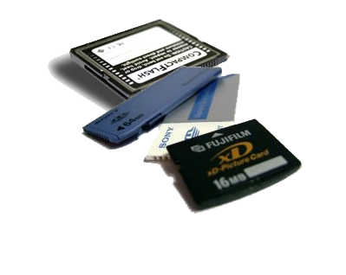
Portable Memory /Sticks

Slide 28
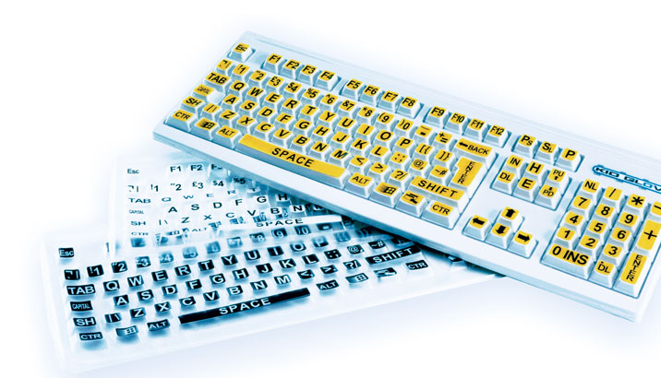

Slide 29
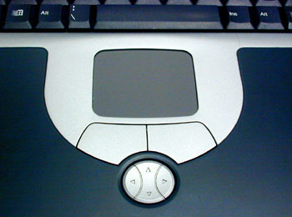
Mouse
Touch Pad
Tracker Ball

Slide 30
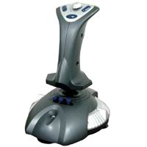

Slide 31
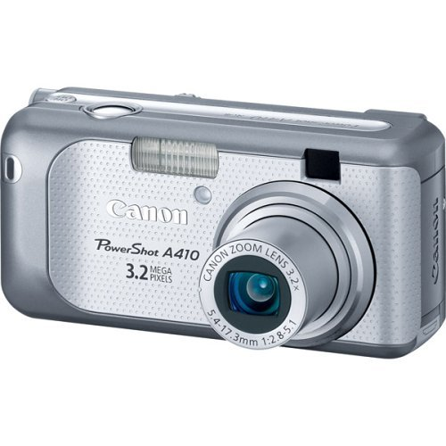

Slide 32
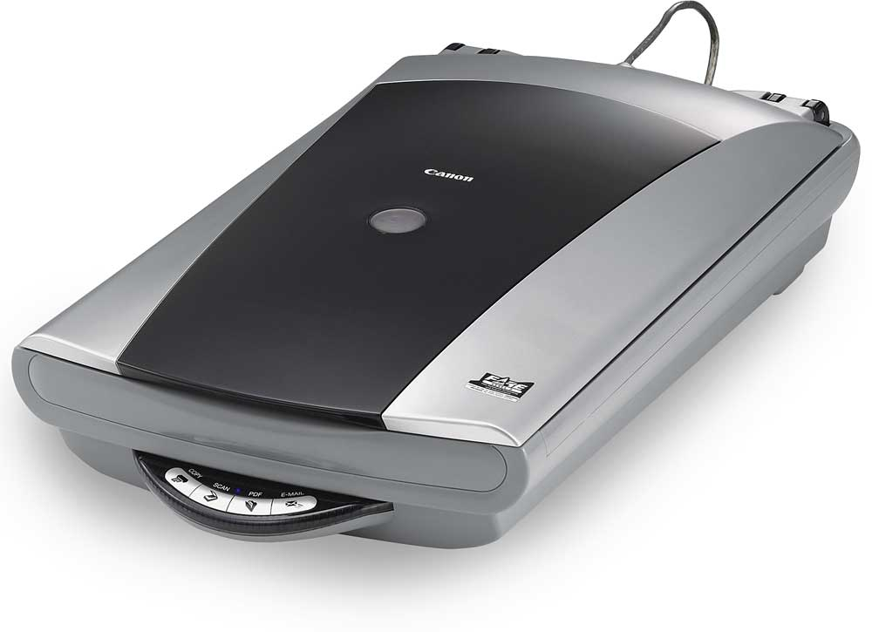
Hand held
&
Flat bed
Scanners

Slide 33
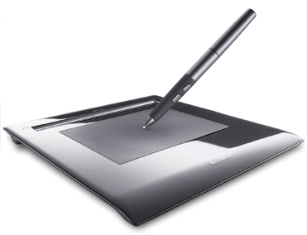
Graphics Tablet

Slide 34
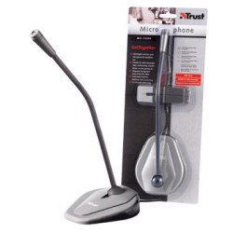

Slide 35
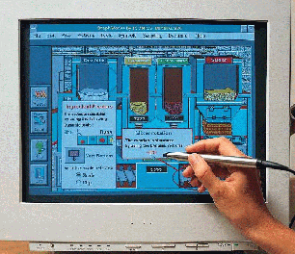
Light Pen

Slide 36
Processor

Slide 38
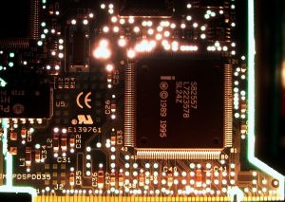

Slide 40
Accessing the Internet
Activity 1
There are a wide variety of devices which can be used to access the internet. Some of these devices are traditional and some have only become available in recent years. It is important to understand the appropriateness of these sources for different users and different purposes.
Using a range of sources (mainly online), research the different methods which can be used to access the internet. Remember you should consider the validity of your sources before completing the table on the next slide.

Slide 41
Technology | Advantages | Disadvantages | Sources
Laptops
Personal computers
Smart phones
Tablets
Games consoles
Digital television

Slide 42
Activity 2
Different devices are appropriate for different types of users. Look at the scenarios below and decide which device would suit each user. Using the knowledge you gained in task one, justify the choice of device for each user.
Scenario | Device | Justification
Pheobe is a student who travels by train to university on a daily basis. She likes to work in the library when completing essays or studying for an exam.
Shivam likes to play games against his friends, enjoys watching films using streaming services and sometimes needs to browse the internet for shopping purposes. He already has a laptop for his studies but it is slow.
Paul and Emily are retired and have a daughter who lives in Australia. They miss being able to see their daughter face to face and have recently been using Skype at the local library to talk to her. Paul prefers to shop in shops and does not trust internet banking. Emily would like to learn how to use the internet more effectively.

Slide 43
KS4 Transition – Year 9 to Year 10
Subject: Cambridge National in Creative iMedia
Contact: Hollie Danby, Will O’Dowd
Exam Board: OCR
Type of Assessment: Two exams, Practical Assignments.
Pre-Reading List:
Cambridge National Level 1/2 Creative iMedia Student eTextbook. Author: Kevin Wells, Victoria Allen, Sarah McAtominey, Tony Stephens
Useful Links:
https://tinyurl.com/yb4mkg9p
https://www.bbc.co.uk/bitesize/subjects/z34k7ty
"Transforming lives through learning"
Key Terminology
Analyse, Construct, Design, understand, interpret, plan, develop, create, brief, test, portfolio
Subject Specific Terminology
digital graphics, multimedia, file types,
Activities to complete before joining:
Create an illustrated Power Point of 4 slides on your ‘favourite games character’.
Describe the character. Tell me why you like this character. Tell me what game the character exists in. Include a picture of you playing the game When you have completed the Power Point save it to USB and bring it along to college on your first day.
A teacher will copy your work and provide you with feedback.

