Slide 1
KS4 Transition – Year 9 to Year 10
Subject: OCR Manufacturing
Contact: Sarah Crookes
"Transforming lives through learning"
Exam Board: OCR Cambridge National
Course Outline: Study engineering materials, processes and production and develop workshop skills. Manufacture an item both manually and using computer aided manufacture.
Type of Assessment:
25% exam 75% coursework
Key Terminology
Define Explain Demonstrate
Compare Select Evaluate
Assemble Construct Design
Subject Specific Terminology
Materials, processes, manufacturing, polymer, metal, smart material, properties, machining, shaping.
Pre-Reading List
https://www.ocr.org.uk/qualifications/cambridge-nationals/engineering-manufacture-level-1-2-award-certificate-j832-j842/qualification-at-a-glance/
Activities to complete before joining:
See slides 2 and 3 for the activity and slide 4 for an extension task.
Useful Links:
https://www.bbc.co.uk/bitesize/examspecs/zdvb2sg
http://www.technologystudent.com/designpro/matintro1.htm

Slide 2
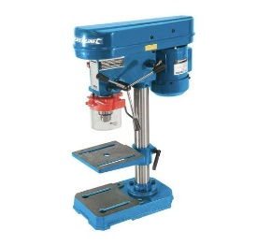
When designing and manufacturing engineered products the correct selection of materials is vitally important. Careful consideration must be taken of the material’s properties and its suitability for the manufacturing and machining processes and the working life of the component or product.
1. Look at the photographs of a range of engineered products and match them (by drawing a line as shown) to the most appropriate material for their manufacture. The first one is done for you!
2. Write bullet points about why the particular material is most suitable for the application/use. What are it’s properties?
Engineered Product |  | Match | Materials | Properties
 | Machine bases |  | Bronze (non-ferrous)
 | Boat propellers |  | Acrylonitrile-Butadiene-Styrene (ABS)
 | Telephone casing |  | Cast iron (ferrous) | • Easy to cast • Low melting point • Easy to machine • Resistant to deformation and wear resistant • Brittle – but good in compression • Ferrous so corrodes (rusts)
Hint: You might need to research the materials on the internet

Slide 3
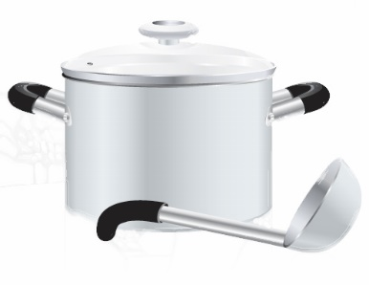
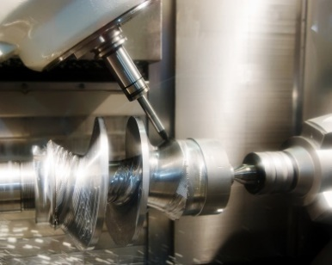
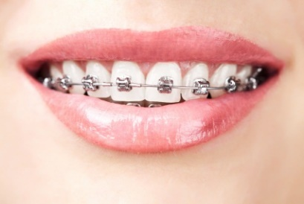
Engineered Product |  | Match | Materials | Properties
 | Heat resistant pan handles |  | Shape Memory Alloy (SMA)
 | Cutting tool tips |  | Phenol-formaldehyde
 | Bicycle frames |  | Tungsten carbide
 | Dental brace |  | Carbon fibre

Slide 4
Extension Activity
Pick a piece of sporting equipment. It might be used in a sport you take part in or something new to you.
You need to research the material it is made from and write down what this is (it may be made up from more than one material).
You then need to write about why that material was chosen. What makes it suitable for the use you have chosen? What techniques were used to shape it into the correct form? What happens if it breaks?
You should write your answer in full sentences to fully explain why the material has been chosen.

Slide 5
KS4 Transition – Year 9 to Year 10
Subject: Systems & Control
Contact: Tony Jordan
Simon Ross
Exam Board: OCR
Course Outline: 75% Coursework including electronic circuit design, construction & testing. Use of simulation software for circuit design & control systems. Design & production of functioning controlled system.
25% External exam to establish knowledge & understanding of electronic theory.
Pre-Reading List:
Use following link to BBC Bitesize, select GCSE Design & Technology, then select OCR followed by electronic systems
https://www.bbc.co.uk/bitesize/guides/zbj8jty/revision/1
Useful Links: (both are FREE downloads for home use)
https://picaxe.com/
https://www.yenka.com/en/Yenka_Electronics/
"Transforming lives through learning"
Key Terminology:
Level 1 Pass, Merit, Distinction
Level 2 Pass, Merit, Distinction
[Level 2 achievement equivalent to GCSE pass grades]
Subject Specific Terminology:
Electronics, Components, Simulation, Control, Input, Process, Output, Series, Parallel
Activities to complete before joining:
Use both Yenka & PICAXE to gain some familiarity with their functions, they have exercises & help pages to develop knowledge, understanding & skills. This early introduction will be very supportive of your Y10 learning at UTC within Engineering.

